Slide 1

Microsoft Teams
Architecture
Deep Dive
Maarten Eekels
Chief Digital Officer Portiva Microsoft MVP + RD
@maarteneekels

Slide 3
Logical architecture
Apps
Teams
Chats
Tabs
Voice
Chat
Office 365 Groups
Team
Apps
OneDrive for Business
Contacts
SharePoint
Channel
Activity Feed
Folder
Meetings
SharePoint
Tabs
Calling
Folder
Images, Emojis, Stickers, Recordings
TEAMCHANNEL#0
Voice mail
Message
Reply Chain

Slide 4
Technical architecture
Teams Clients
Web
Desktop
iOS
App
Android
App
Graph API
Electron
Services
Web
Companions
Audio /
video
Telemetry
Settings and
O365 access
Messaging
Notes
Files
Files
Other Workloads
OneNote
WAC
OneDrive for Business
SharePoint
Experimentation
Teams services
Chat & Presence services
Calling / Meeting
AAD
MRU
Most recent files
Policy
Exchange
Calendar
Bots
PSTN
Connectors
Publish / Subscribe
Stream Recording
Graph Webhook
Push Notifications
Exchange
Search
Notification service
Information Protection
Email service
SMTP

Slide 5


Where is everything stored?
Message
Chat service table storage (moving to Cosmos DB)
Ingested to Exchange to enable compliance
Image
Media service on Azure (using Blob storage)
Ingested to Exchange to enable compliance
Files
Team files → SharePoint
Chat files → OneDrive for Business
Voicemail
Individual mailbox in Exchange
Recording
Media service on Azure (using Blob storage) (<24 hours)
Encoded to Stream
Stored in OneDrive/SharePoint starting January 11th 2021
Calendar meeting
Individual mailbox in Exchange
Contacts
Exchange
Telemetry
Microsoft Data warehouse (No customer content)

Slide 6
Data flow and the compliance boundary
compliance boundary
Connectors
Data posted to a channel
User Browser, Desktop ,Mobile
Email a channel
Data posted to a channel
Standard Teams user
Giphy
Query to Giphy
Guest added
via AAD B2B
Guest user
Microsoft Teams
Push Notifications (Mobile)
Push notifications to Apple or Google to notify mobile client
Anonymous user
joining a meeting
Anonymous join to a meeting
Other Cloud storage (3rd party)
Optional Box, Dropbox, Google drive, Citrix ShareFile
URL Preview
Get a preview of a URL that is posted to a message
Communication between multiple tenants
Federation communication
Tabs
Any third-party tab is hosted outside the compliance boundary
Apps/Bots
Any third-party App/bot or line of business app is hosted outside the compliance boundary
Graph API
Graph APIs can be exposed to line of business apps or 3rd party apps
Calling Plan (PSTN)
Enables inbound/outbound calling outside the organization
2-way communication
Inbound data
Outbound data

Slide 7


Teams client architecture
Desktop
Mobile
Web
Windows
Mac
iPhone/iPad
Android
Electron
iOS
Android
C++
Objective C
HTML5/CSS
Angular → React
jQuery, lodash, etc. (200+ Open Source Components)
Swift
Java
TypeScript, Node, SASS
(Some) React Native
Browsers: Edge Chromium, latest Chrome, latest Firefox, Safari, Edge Legacy (ends March 9, 2021) - IE11 ended November 30, 2020 (August 17, 2021 for all other M365 apps and services)
Desktop: Windows 10, 8.1, 7(SP1), Mac OS X 10.10+
Auto-updates

Slide 8
Memberships and roles
 | Team Owner | Team Member | Team Guest
Leave team | ✓ | ✓ | ✓
Edit team name/description | ✓ | - | -
Delete team | ✓ | - | -
Create/update channel | ✓ | ✓* | ✓*
Create private channel | ✓ | ✓* | -
Delete/restore channel | ✓ | ✓* | ✓*
Edit messages | ✓ | ✓* | ✓*
Delete messages | ✓* | ✓* | ✓*
Manage tags | ✓ | ✓* | -
Add members | ✓ | - | -
Add tabs | ✓ | ✓* | -
Add connectors | ✓ | ✓* | -
Add bots | ✓ | ✓* | -
* Can be restricted
through Team
Settings by the owner

Slide 9
Teams admin roles
Teams Service Administrator: The overall Teams workload admin, who can also manage and create O365 Groups.
Teams Communication Administrator: This role can manage meetings and calling functionality in Microsoft Teams.
Teams Communications Support Engineering: Users who are assigned this role have access to advanced call analytics tools.
Teams Communications Support Specialist: This role has access to basic call analytics tools.
Group Administrator: Users in this role can create/manage groups and its settings like naming and expiration policies.

Slide 10
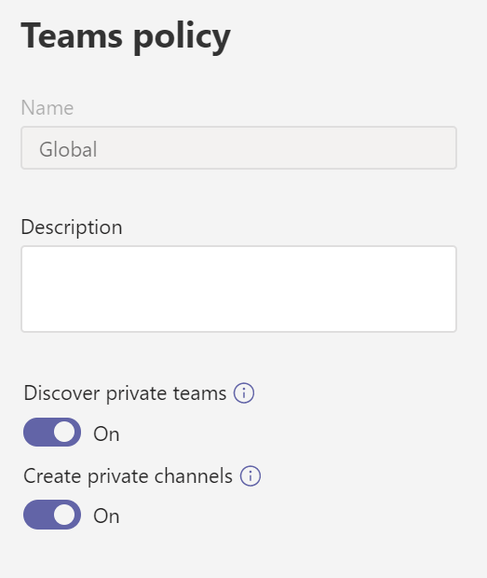
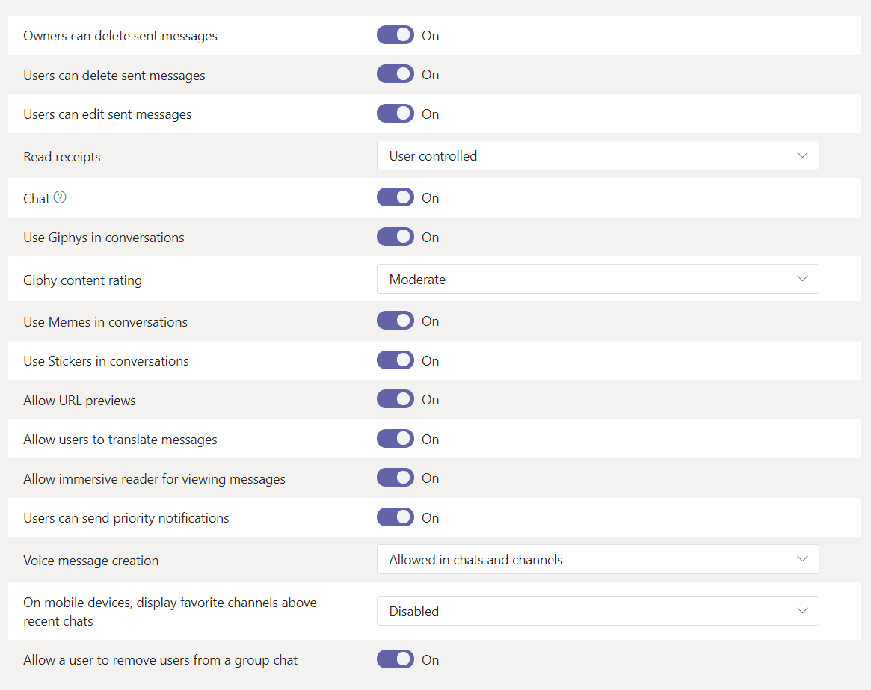
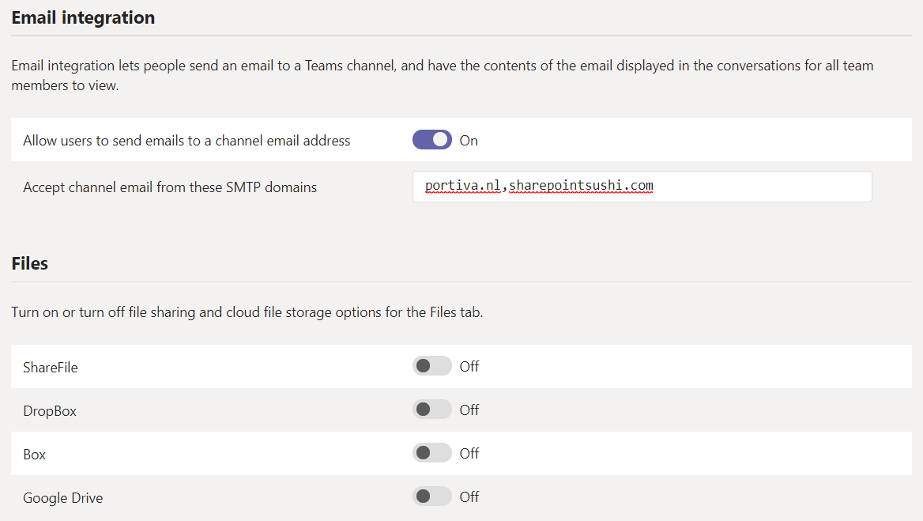
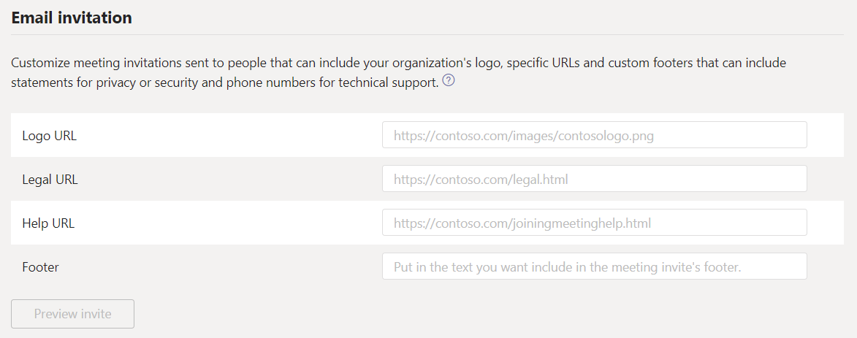


Settings on tenant level

Slide 11
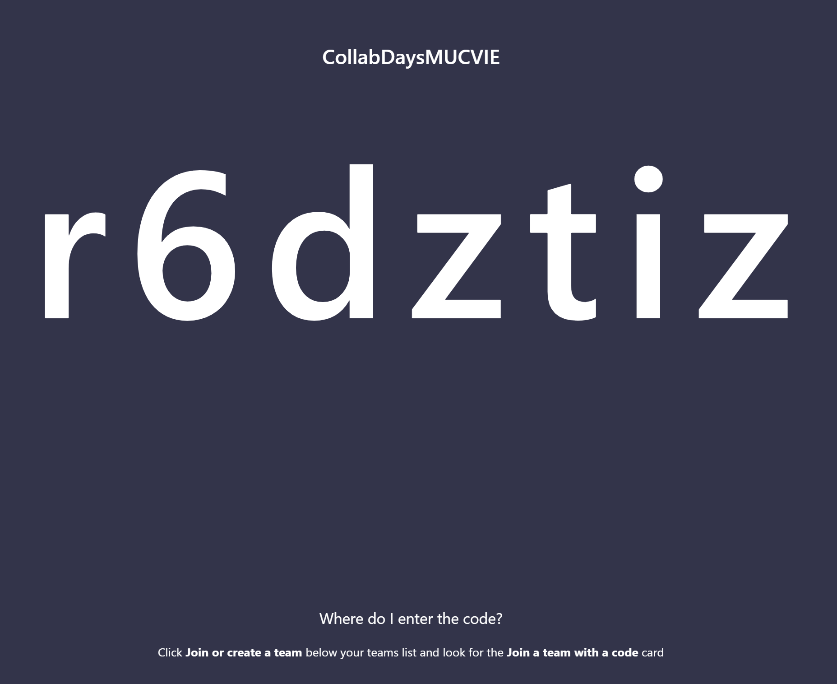
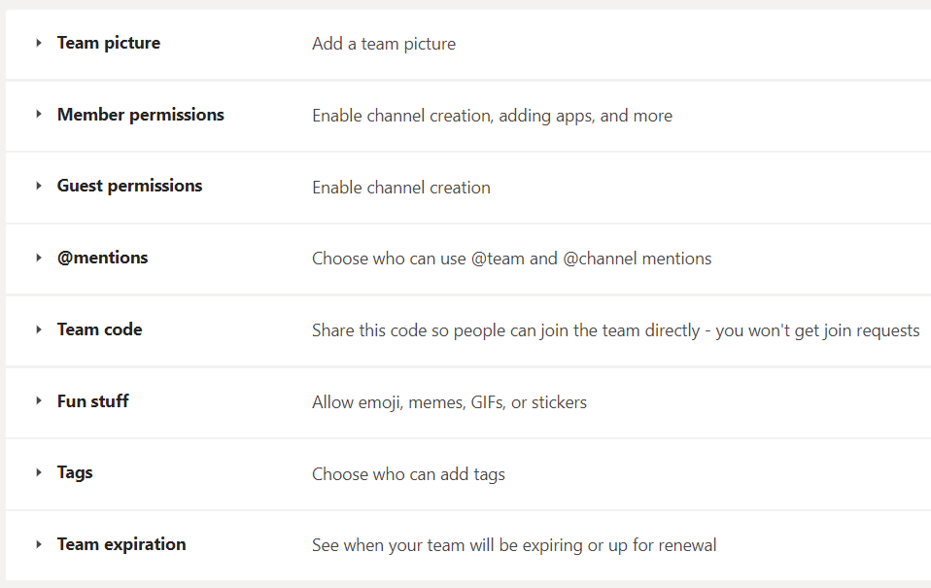
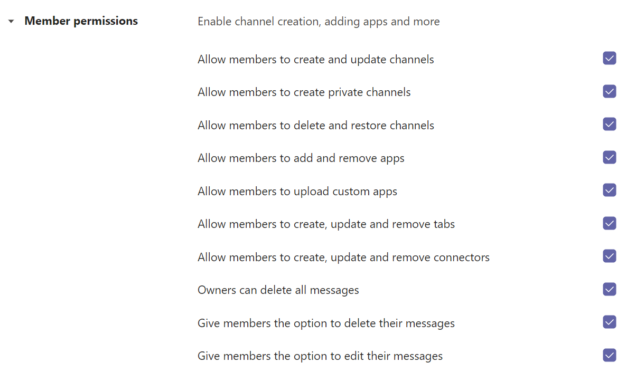
Settings on team level

Slide 12
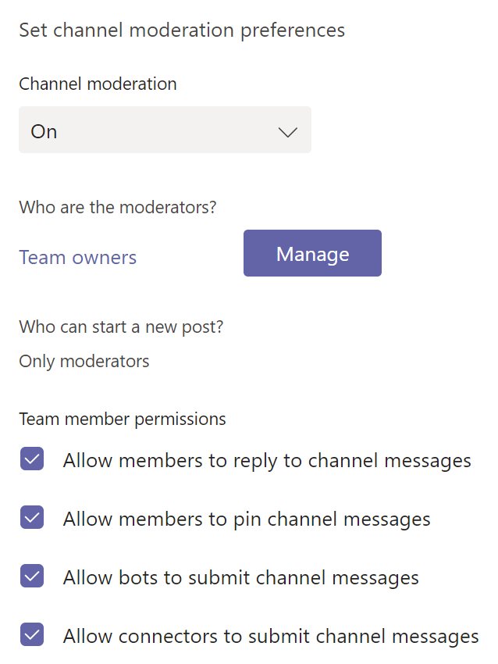
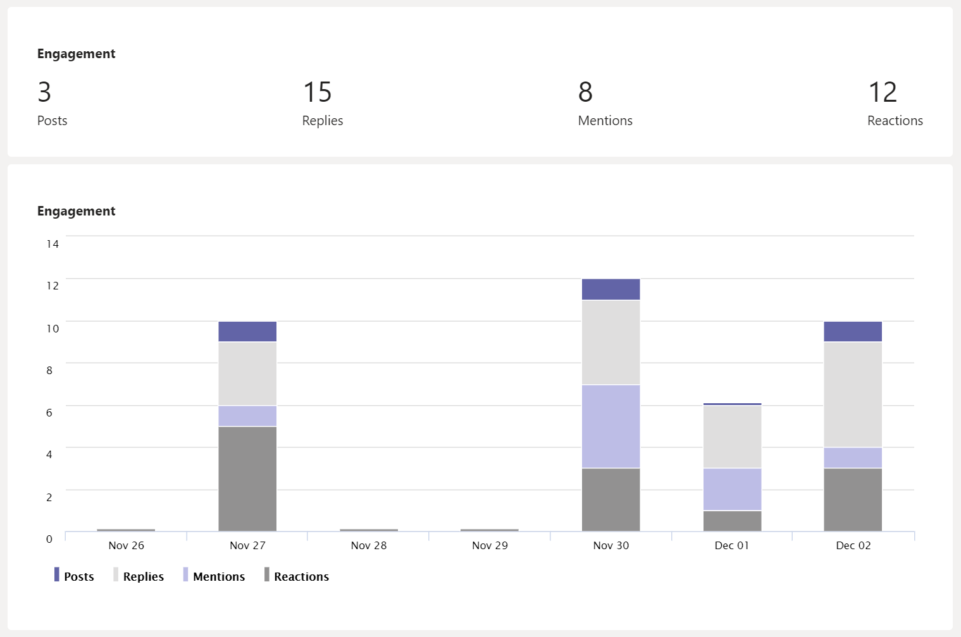
Settings on channel level

Slide 13
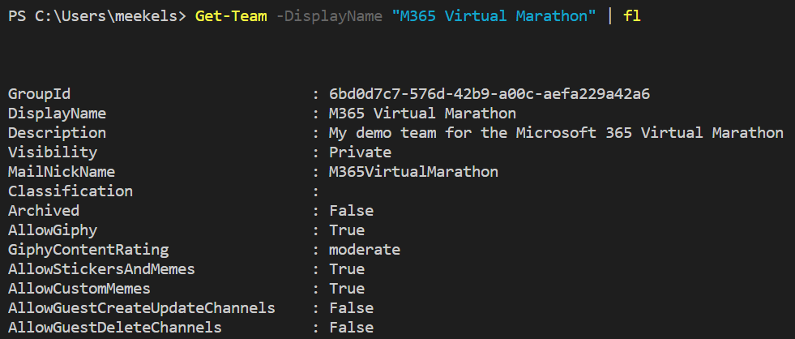
Manage Teams with PowerShell
Install-Module -Name MicrosoftTeams
$GroupId = (Get-Team -DisplayName “<Team name>").GroupId
Get-Team -DisplayName “<Team name>" | fl
Set-Team -GroupId $GroupId -<setting name> <boolean>

Slide 14
Restrict team creation
Connect-AzureAD
Get-AzureADDirectorySetting
$Policy = Get-AzureADDirectorySettingTemplate –Id 62375ab9-6b52-47ed-826b-58e47e0e304b
$Setting = $Policy.CreateDirectorySetting()
$Setting[“EnableGroupCreation”] = “false”
$Setting[“GroupCreationAllowedGroupId”] = “your security group ID”
New-AzureADDirectorySetting -DirectorySetting $Setting

Slide 15
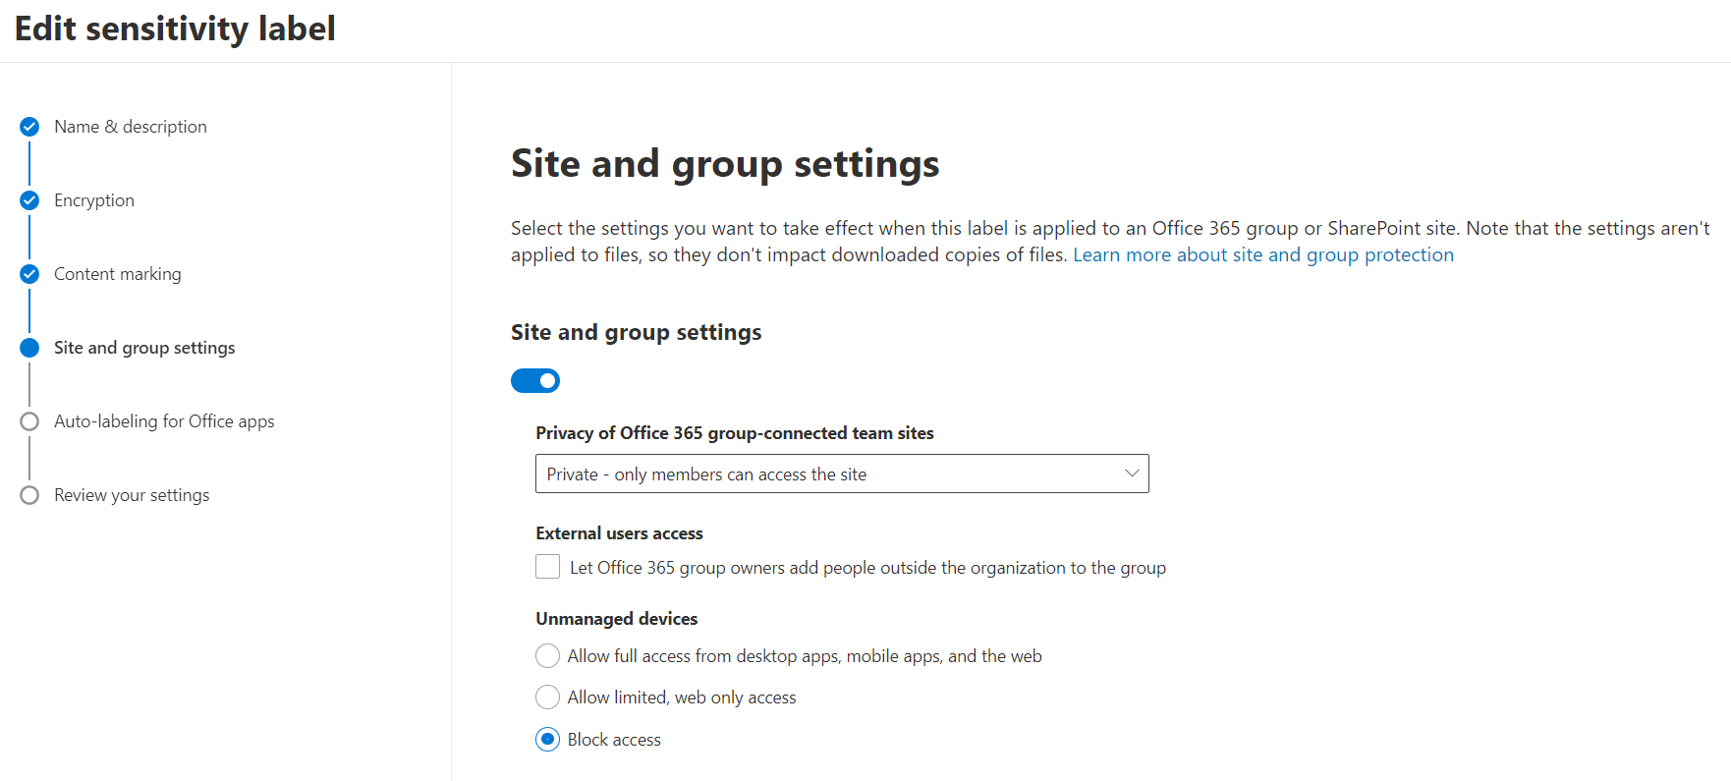
External guest access
Default setting: Off for tenants / On for individual Teams
Disabling or enabling external guest user access for individual Teams is only possible through PowerShell
$template = Get-AzureADDirectorySettingTemplate | ? {$_.displayname –eq "group.unified.guest"}
$settings = $template.CreateDirectorySetting()
$settings["AllowToAddGuests"]=$False
$groupID = (Get-AzureADGroup -SearchString “<your group name").ObjectId
Get-AzureADObjectSetting -TargetObjectId $groupID -TargetType Groups | fl Values
New-AzureADObjectSetting -TargetObjectId $groupID -TargetType Groups -DirectorySetting $settings
Get-AzureADObjectSetting -TargetObjectId $groupId -TargetType Groups | Set-AzureADObjectSetting
-TargetObjectId $groupId -TargetType Groups -DirectorySetting $settings

Slide 16
DEMO

Slide 17
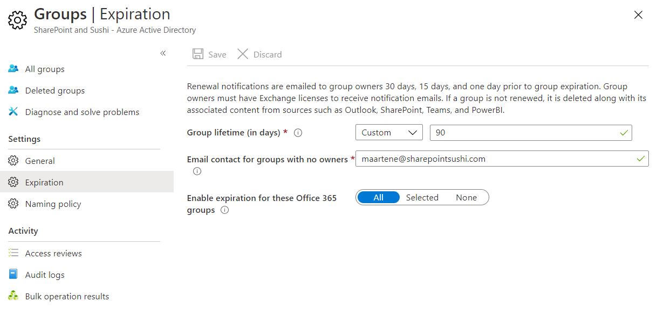
Groups expiration policy

Slide 18
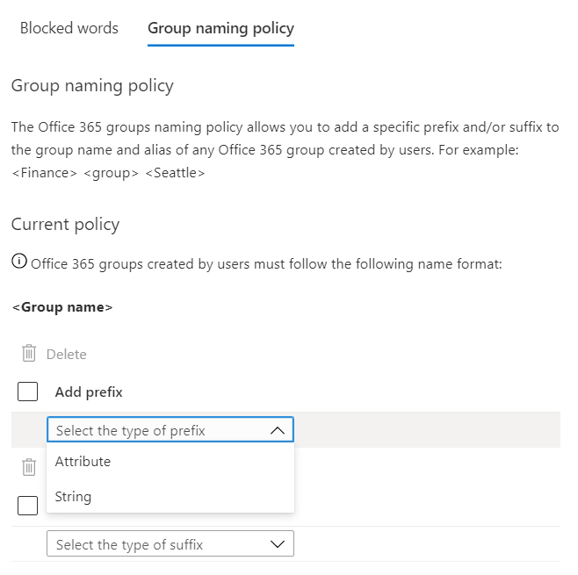
Naming conventions
Get-AzureADDirectorySetting
$directorySetting = Get-AzureADDirectorySetting -Id 92efeacc-89c6-4c16-b1cf-107aaf87f7dc
$directorySetting.Values
$directorySetting["PrefixSuffixNamingRequirement"] = "Grp_[Department]_[GroupName]"
$directorySetting["CustomBlockedWordsList"]="Payroll,CEO,HR"
Set-AzureADDirectorySetting -Id (Get-AzureADDirectorySetting | where
-Property DisplayName -Value "Group.Unified" -EQ).id
-DirectorySetting $directorySetting

Slide 19
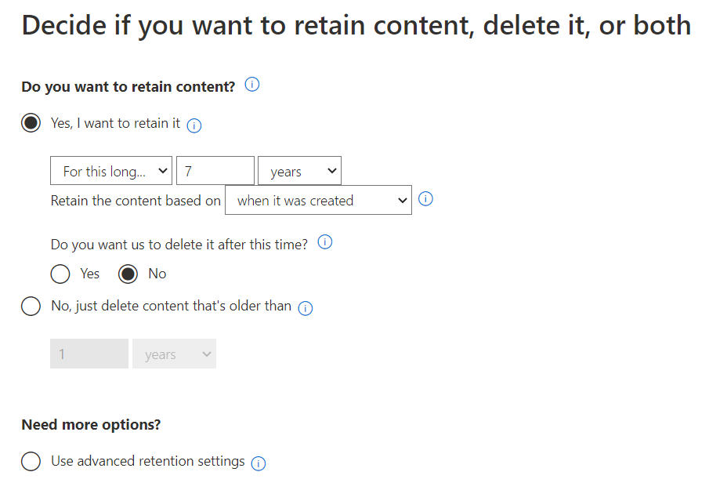
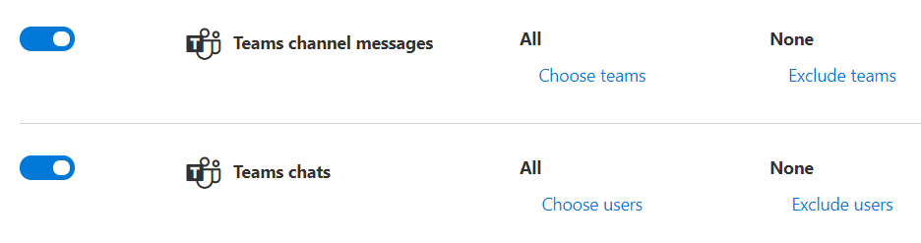
Retention policies

Slide 20
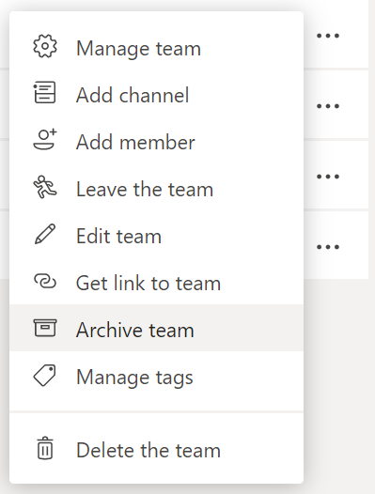
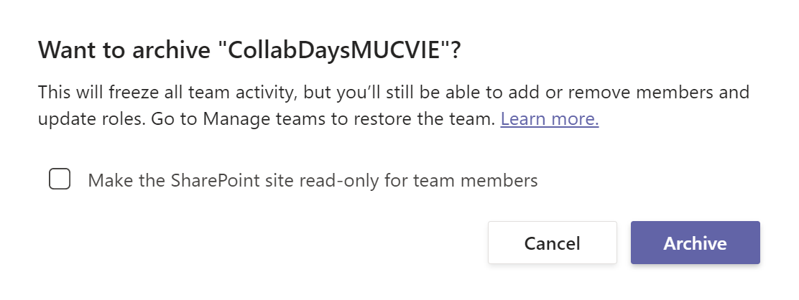
Archiving teams

Slide 21
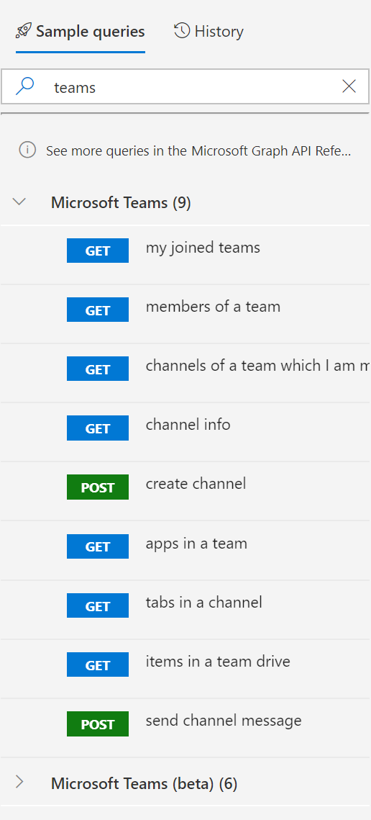
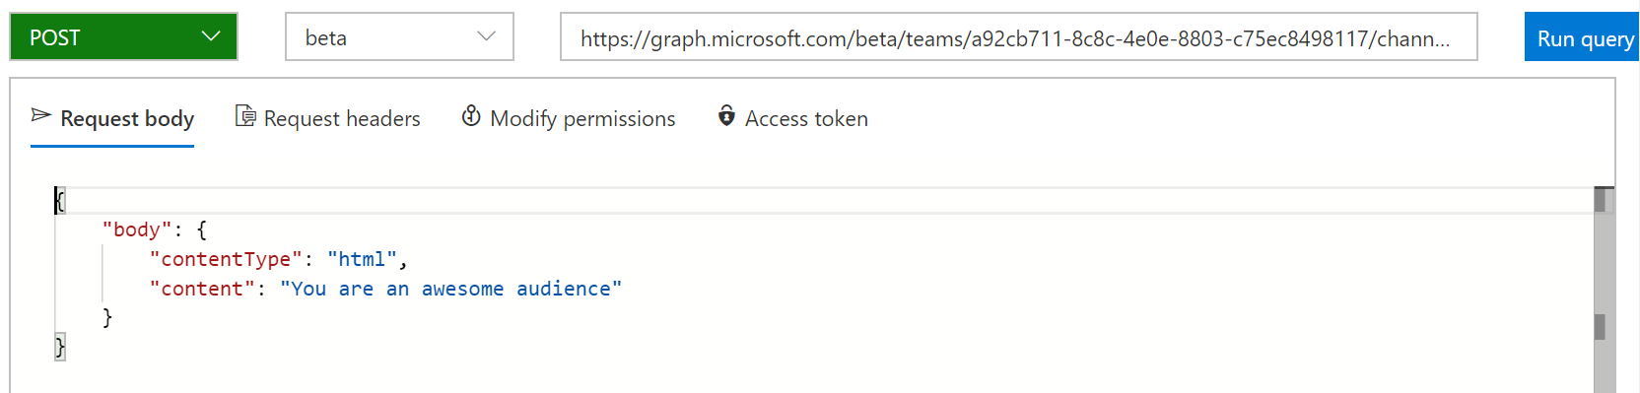
Microsoft Graph API

Slide 22
DEMO

Slide 23





Thank you @maarteneekels

